Slide 1


Data Retrival
PYTHON IN FINANCE

Slide 2


Everything Is Data
DIGITAL PIONEERS
READINGS
https://privops.com/blog/2017/5/19/everything-is-data
https://www.youtube.com/watch?v=nAWK89Ei54w

Slide 3
Data Sources
DIGITAL PIONEERS
Excels
Word / Pdf
Image
Emails & attachments
APIs
Videos
Others…
READINGS
https://privops.com/blog/2017/5/19/everything-is-data
https://www.youtube.com/watch?v=nAWK89Ei54w

Slide 4
API
DIGITAL PIONEERS
What is an API?
Application Programming Interface
A URL
A gateway / agent / middleware to provide / receive the data
READINGS
https://www.youtube.com/watch?v=SLwpqD8n3d0

Slide 5
JSON
DIGITAL PIONEERS
What is JSON?
A data format
Key and value
READINGS
https://privops.com/blog/2017/5/19/everything-is-data
https://www.youtube.com/watch?v=nAWK89Ei54w

Slide 6
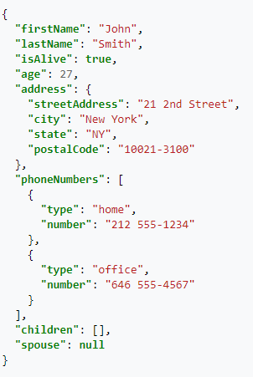
JSON
DIGITAL PIONEERS
Example
READINGS
https://www.w3schools.com/whatis/whatis_json.asp

Slide 7
Data Sources
DIGITAL PIONEERS
Excel
Word / Pdf
Image
Emails & attachments
APIs
Videos
Sound
Others…
READINGS
Read PDF and Word By Python
Read Image By Python
Read Emails By Python
GetData From APIs By Python

Slide 8
Data Sources
DIGITAL PIONEERS
Excel
Word / Pdf
Image
Emails & attachments
APIs
Videos – a collection of images
Sound – Voice to text conversion
Others…
READINGS
Read PDF and Word By Python
Read Image By Python
Use tesseract To Read Image
Read Emails By Python
GetData From APIs By Python

Slide 9
Data Retrieval
DIGITAL PIONEERS
DEMO
READINGS

